Slide 1



MedBuddy: The Future of Medication Adherence is Here
Imagine a world without missed doses. Technology keeps you on track. Locate pharmacies and get rewarded for good health. MedBuddy makes this future a reality.
Team MedBuddy

Slide 2
The Global Crisis: Medication Non-Adherence Explained
Medication non-adherence is a worldwide problem. 50% of patients don't take their medication as directed. This leads to increased hospitalizations. It also results in increased healthcare expenditure.
Worldwide Problem
High Percentage
Medication non-adherence is a global issue.
50% of patients do not adhere to their medication.

Slide 3

Introducing MedBuddy: Your Personalized Health Companion
MedBuddy is your personalized health companion. It's designed to help you manage your medications. Never miss a dose again. Improve your health outcomes.
Smart Reminders
Pharmacy Locator
Rewards System

Slide 4
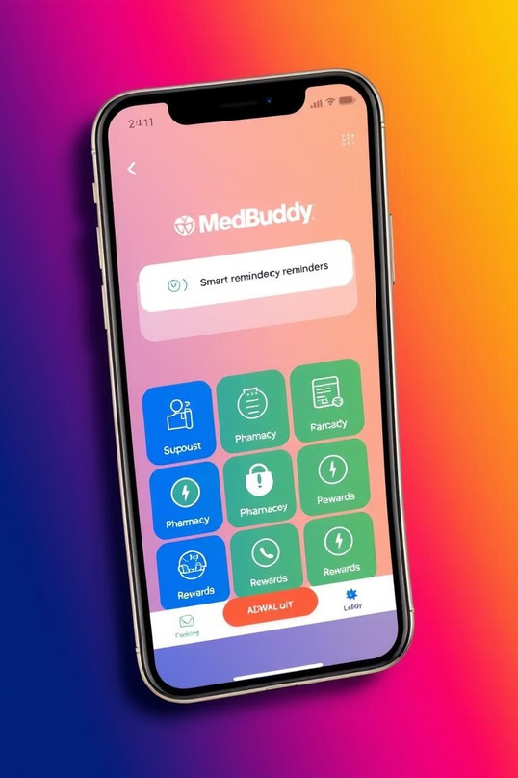
Key Features: Smart Reminders, Pharmacy Locator, and Rewards
1
2
Smart Reminders
Personalized reminders ensure you never miss a dose.
Pharmacy Locator
Find the closest pharmacy in case of emergencies.
3
Rewards
Earn rewards for adhering to your medication schedule.

Slide 5
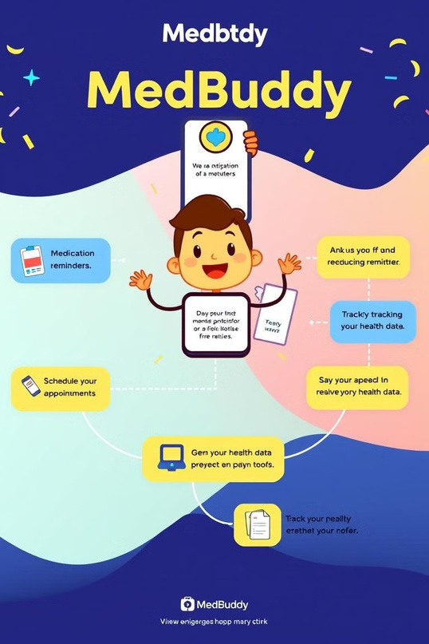
How MedBuddy Works: A Seamless User Experience
MedBuddy offers a seamless user experience. Simply download the app. Enter your medication details. Receive personalized reminders and rewards.
1
Signup
2
Enter Medication Details
3
Receive Reminders & Rewards

Slide 6

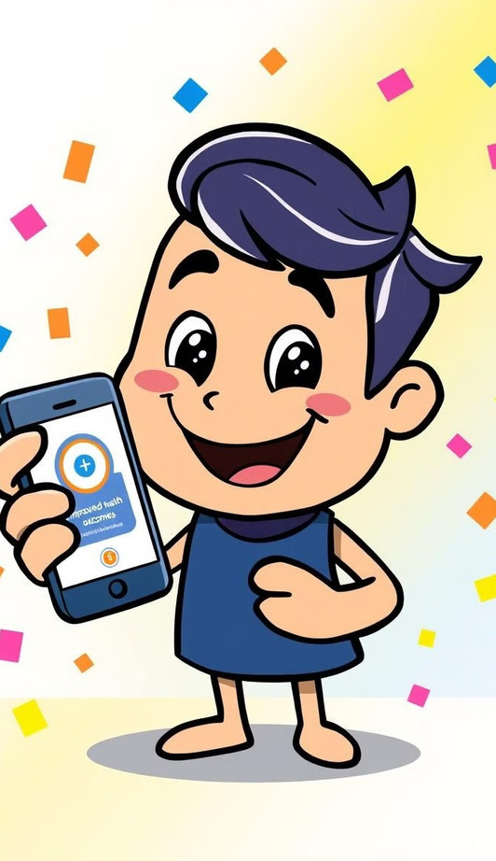
The Impact: Better Health Outcomes and Reduced Costs
MedBuddy leads to better health outcomes. Reduced hospitalizations and increased medication adherence. Lower healthcare costs for individuals and the system.
50%
25%
Hospitalizations
Reduction in hospitalizations.
Adherence
Increase in medication adherence.
$100M
Savings
Potential savings in healthcare costs.

Slide 7
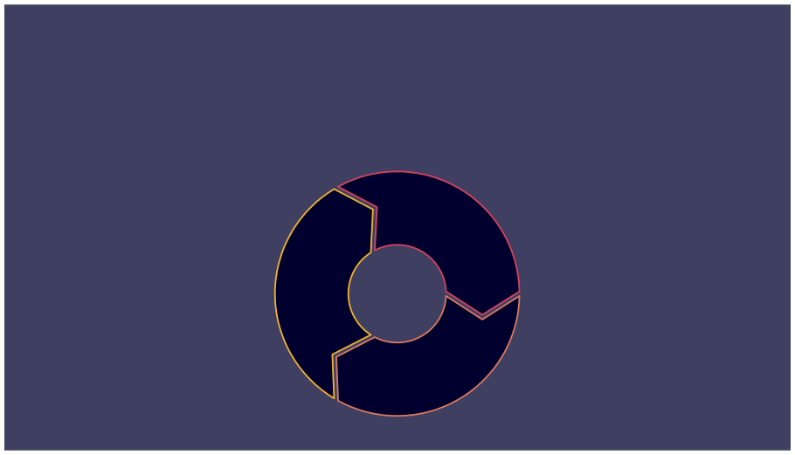

Join the MedBuddy Movement: Invest in a Healthier Future
Invest in a healthier future with MedBuddy. Help us improve medication adherence. Support better health outcomes for everyone.
2
Improve
1
Invest
Support
3

